Slide 1
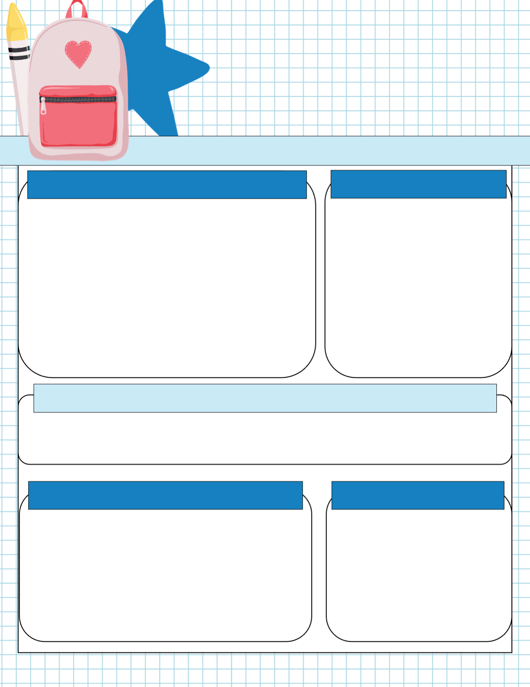

Scoil Éanna
Newsletter
Rang a Ceathair
Monthly Roundup
6th class celebrated their confirmation as 2nd class made their 1st Confession. Well done to our girls and boys teams that took part in plenty of competitive sports over the past number of weeks. We had GAA mini 7’s, the FAI soccer mini 7’s in Gortakeegan, our cross country running team, and our boys hurling team all giving a great account of themselves. We celebrated Seachtain na Gaeilge, world book day and Engineering week. We are very proud of our Newly appointed Green Dog walkers. Rang a Trí took part in the Design a Book Bag with Monaghan county libraries. The student council organised the “Our Shoes” campaign sending 65 pairs of shoes to South African townships helping those who need them most. Student Council also organised an Easter Egg hunt for infant classes and this was a huge success.
Confirmation
Well done to 6th class for holding their service of Light and Pledge ceremony in the church. Huge congratulations to all the 6th class pupils that celebrated their confirmation. Thank you to Mrs Duffy and Fr. McGinn for helping the children prepare so well for this special day.
Seachtain na Gaeilge
We celebrated Seachtain na Gailge with a wide range of games and activities. We had a fantastic Seisiún Ceoil with children showcasing their fantastic musical abilities. We held our annual Ceoilchoirm Scoile where each class preformed poems and songs as Gaeilge. This was a week was full of fun activities. We finished off the week with a wonderful Lá Glas.
Biodiversity
Reconciliation
Congratulations to rang a dó who celebrated their First Penance in a ceremony of song, story and prayer with Fr.McGinn. Thank you to Ms Brennan for helping the children prepare for this. The children continue to prepare for their upcoming First Holy Communion.
Well done to the Green Schools Committee for showcasing the excellent work that is being done within school to support Biodiversity to a county council representative. We hope to renew our Green schools flag. With the support of Ms Tinnelly the children have been following a weekly litter picking rota. 4th class have been busy creating a cup plant garden. Children planted new trees around the school boundary. 1st and second classes visited Lough Major to learn how we can support Biodiversity in our locality. All classes completed quizzes and workshops to develop our understanding of how to support Biodiversity.

