Slide 1
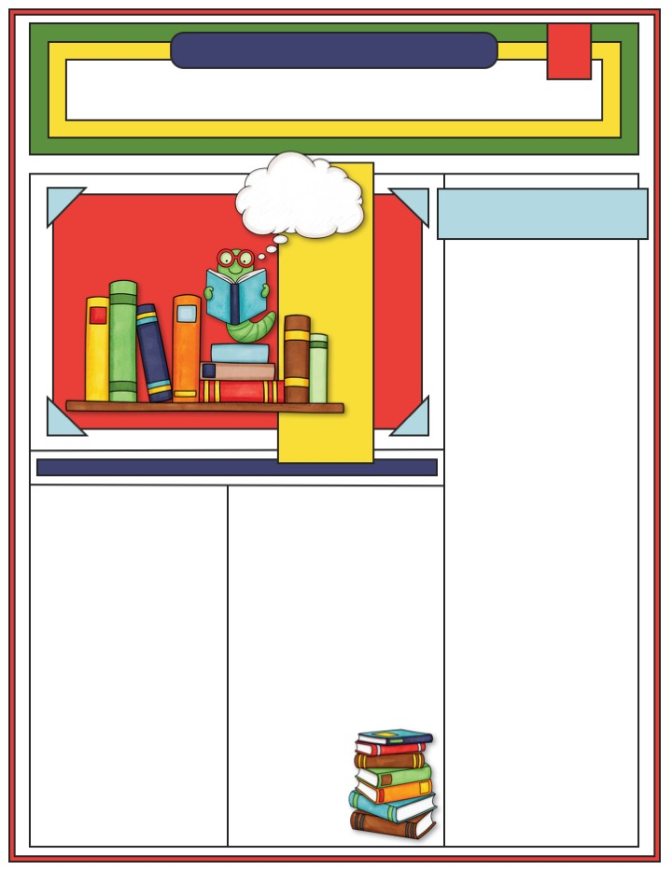
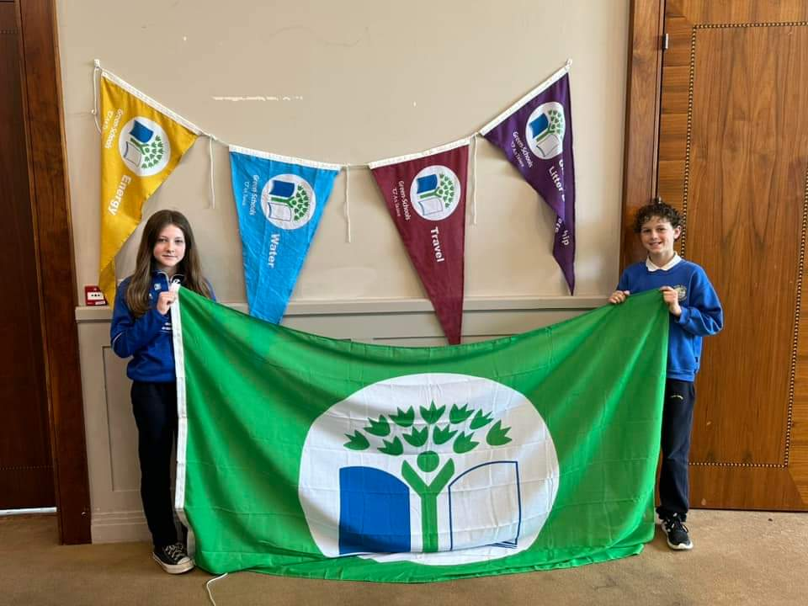
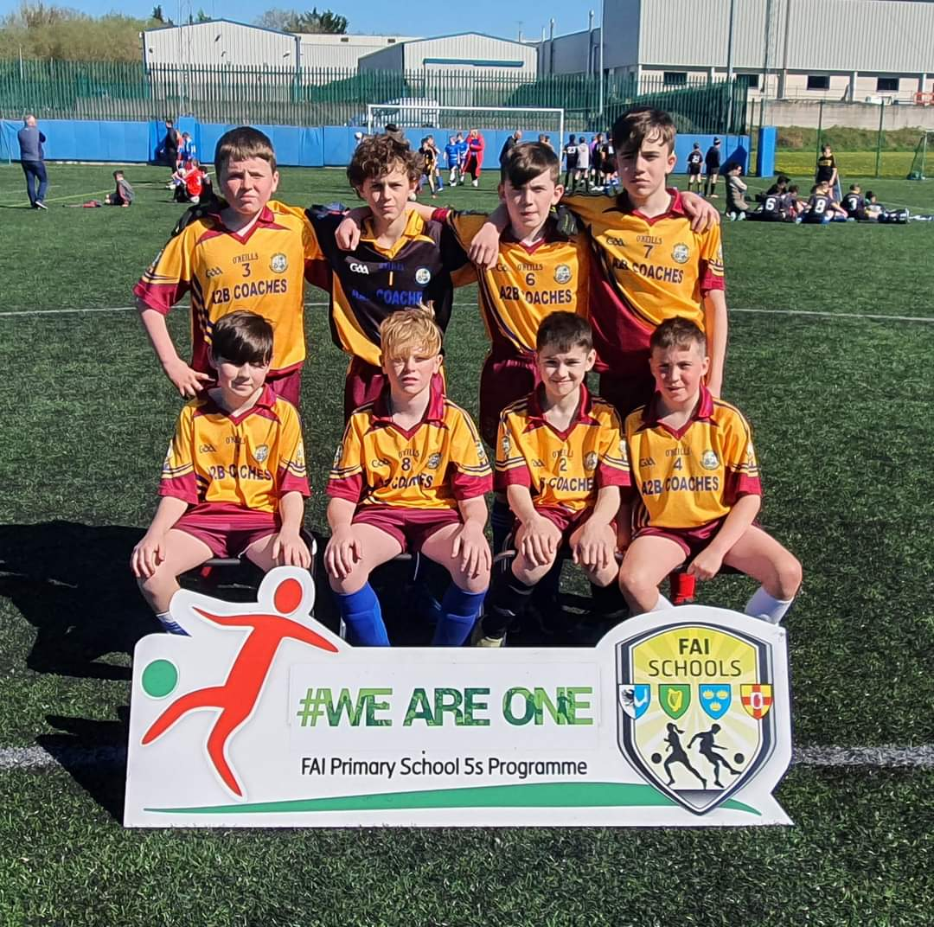
Scoil Éanna
The May Times
Adventure Awaits
In My Shoes
Our Student Council did a shoe appeal for people in African townships. Altogether they collected 102 pairs of shoes. They collected 2nd hand rugby boots, football boots and old sneakers. We are thankful to all the children and parents for donating their shoes that don't fit them.
Girls’ Soccer
Well done to all the girls from 5th and 6th who participated in the girls soccer 5 a side in Gortakeegan. It was on Monday the 9th of May. They were against Gaelscoil Ulltain, Blayney Convent and Loughmourne.
Boys’ Soccer
The Scoil Éanna boys soccer team played at Monaghan United F.C. stadium in Gortakeegan on Thursday the 20th of April. Scoil Éanna drew to Edenmore on a scoreline of 3-3. Another draw followed to Corduff on a scoreline of 2-2. The boys beat The Model School by 5 goals, final score 5-0. Scoil Éanna then beat Killanny 7-0. The team managed to stay unbeaten but ultimately came second place on the table by 2 points to leaders Corduff. Overall it was a great day for the school team.
Green Schools
On the 24th of May 2023 Zach, Kayla, Mrs Murphy and Mrs Woods travelled to City North Hotel Gormanstown, Co. Meath with lots of other schools to obtain the green flag for our school. There were schools from all over Ireland taking part. Scoil Éanna was in the travel category. To get the green flag our school took part in things like W.O.W day (Walk on Wednesday) and we also walked to school for ten days. For each of these days Dovydas and Jonathan recorded the results from each classroom to see who carpooled, walked, cycled or travelled by bus to school. Then Mrs Woods rewarded each pupil a pencil for their efforts. Well done to all the pupils in Scoil Éanna for taking part.
Girls’ GAA
A big well done to all the girls from 5th and 6th class who participated in the Cumann na mBunscol Gaelic football league. They played Urbleshanny, Annyalla, Clontibret and Edenmore. Unfortunately they didn't make it to the final but they all had great fun. Also a big thank you to Mrs Duffy and Ann for taking the girls to all the games and supporting us too.
Team- Kellie Duffy, Kayla Rutledge, Ellie Mulligan, Ellie Mc Connon, Orla Mc Adam, Geraldine Forde,
Ciara Macklin,
Alicia Duffy, Sophie Duffy,
Bethany Smyth,
Amanda J Brady,
Samaya Abdulhamid.

Slide 2
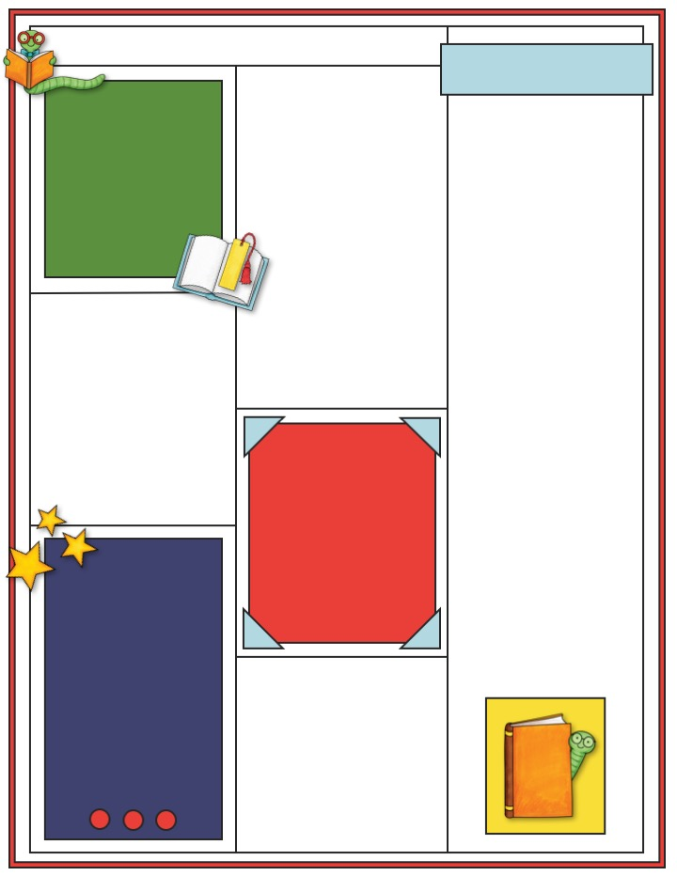
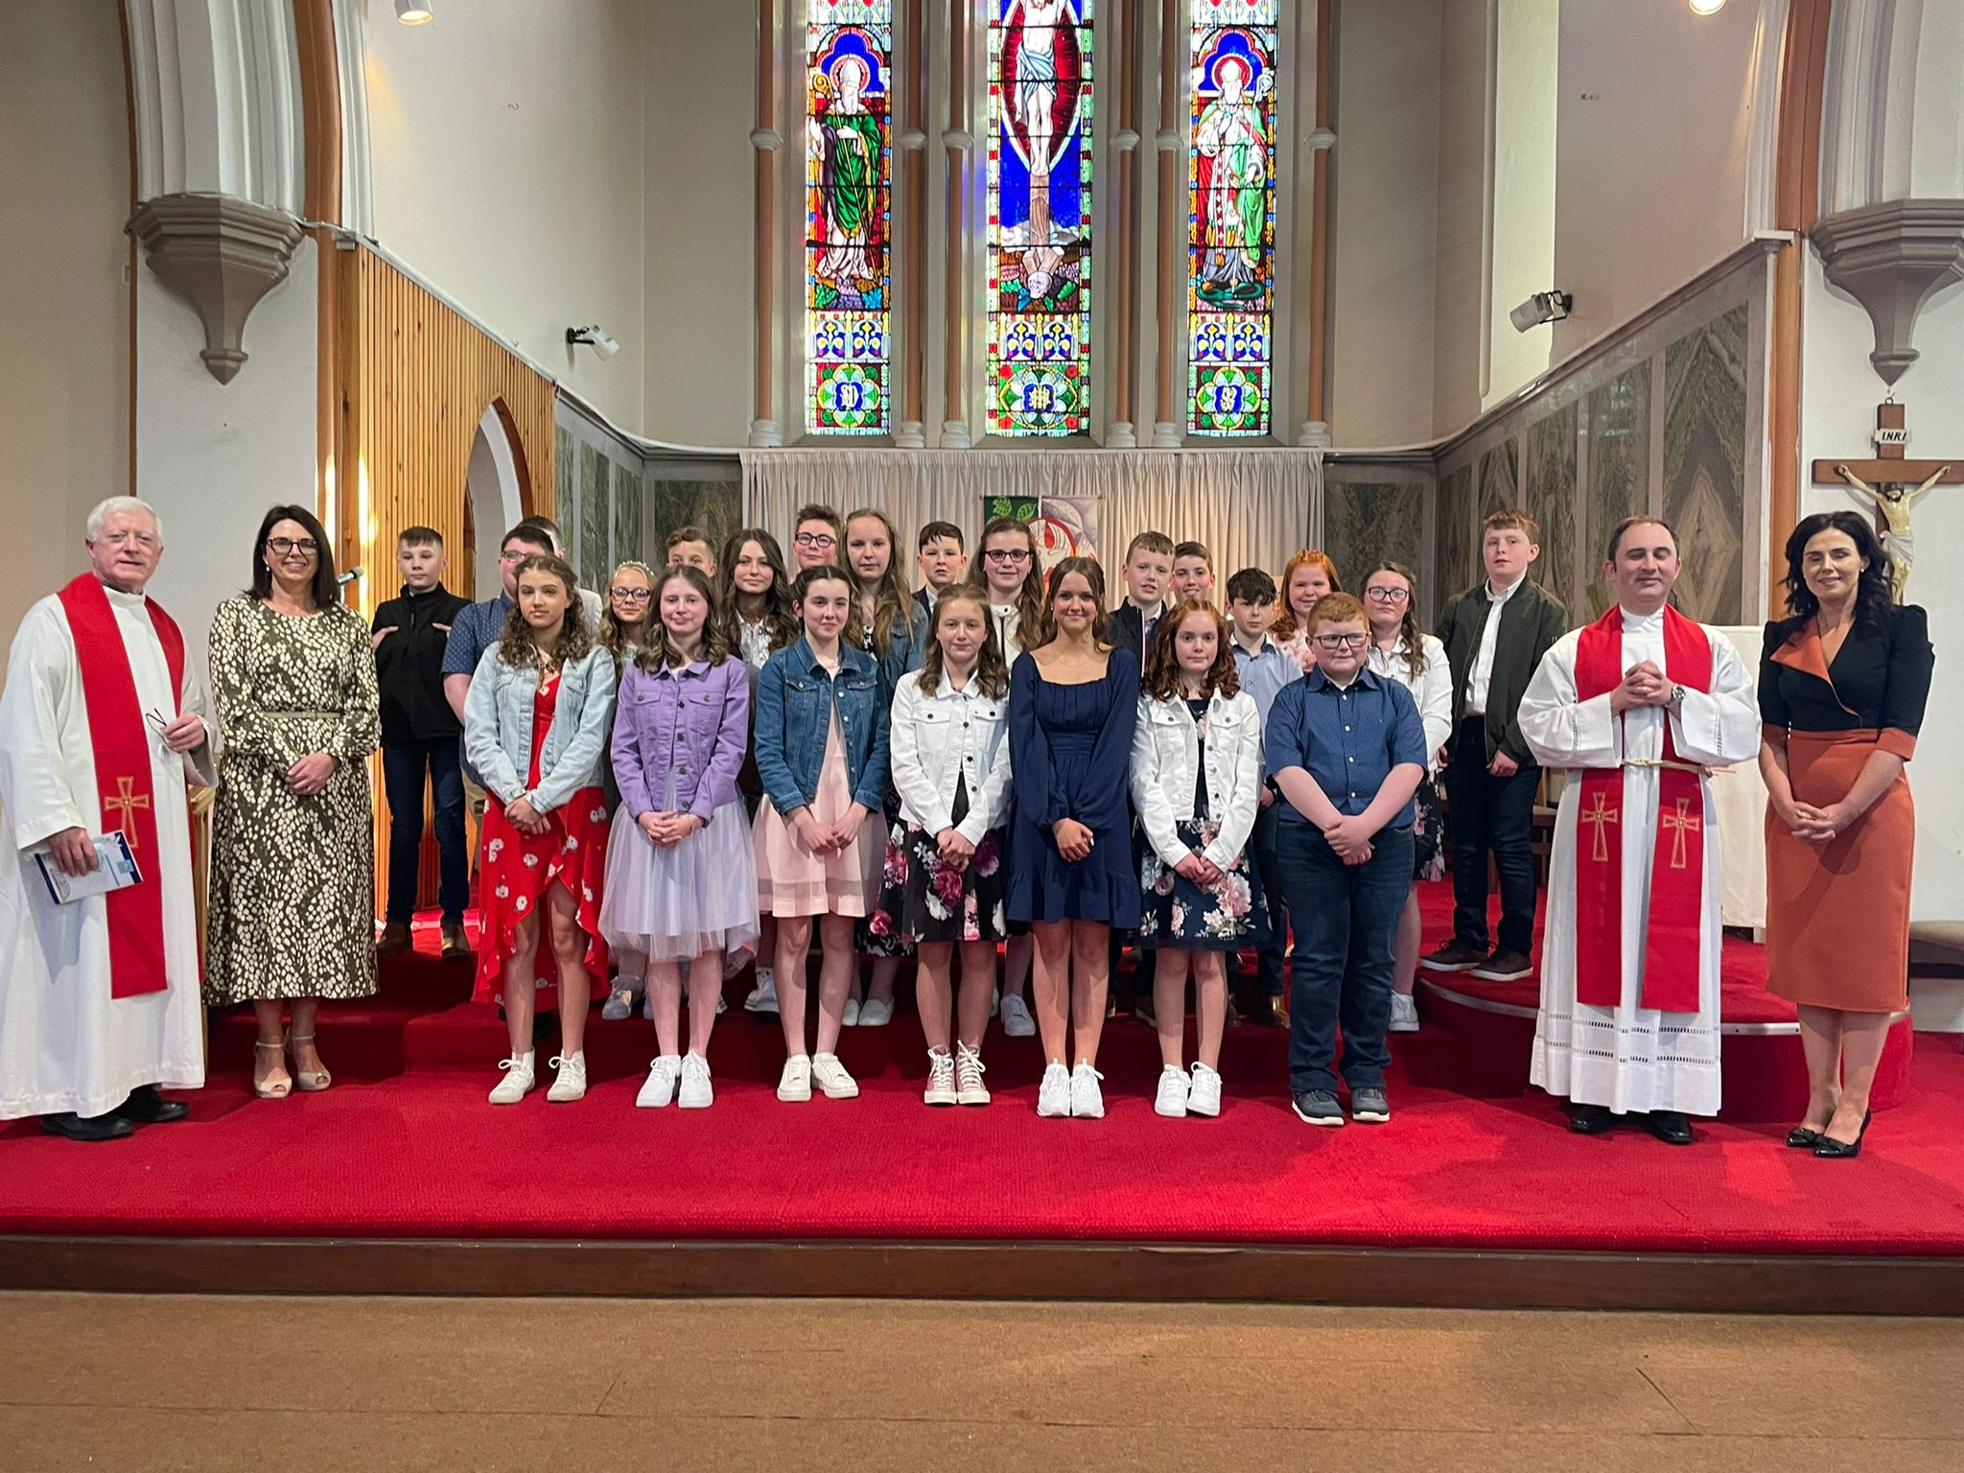
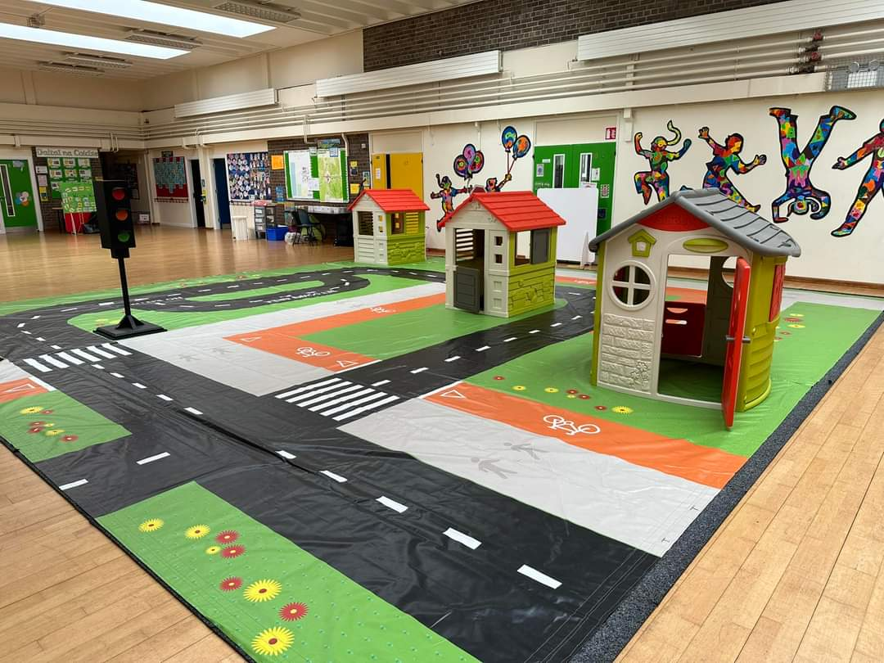
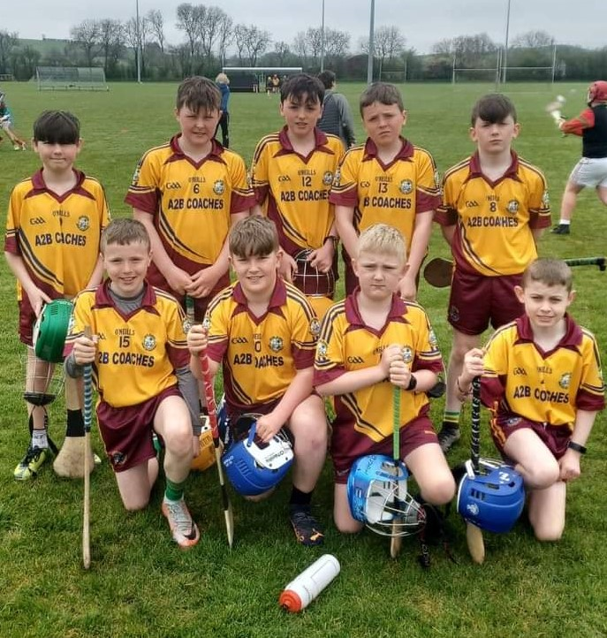
Comhghairdeas
RSA Road Safety
The RSA workshop took place on the 20th to the 23rd of May. Every class in the school completed the workshop and it was 45 minutes long. Everyone had to sit down and the RSA people would talk about the dangers on the road and when they were done they would ask questions about it. Then after that every student played a game. There would be people that would be driving a car, walking or cycling. If you crashed or broke a rule you would be sent to hospital. During that another group would be getting a photo taken. You would get a safety licence with your face put on a card and your name on it.
May
Dalta na Coicíse
Eva Drake/Chloe Steel
Kyle Farei/Caoimhe Quinn
Cian Donnelly/Oliver Duffy
Aodhàn Sammon/Lucia Croakin
Lola Farrelly/Liam Conlon
Grace Smyth/Alex West Seán Leonard/Maryam El Madany
Ryan Gilmore/John Hamilton
Ciara Macklin/Ellie Mc Connon
Maryam El Madany
Gaeiligeoir na Coicíse
Milan Filonenko, Jasmine Traynor, Layla- May Steele, Joshua Harte, Niamh Quinn, Patrick Mc Geough, Kristen Rinkeviciute, Dovydas Pauliukonis, Conor Beggan, Ellie Watters, Victoria Strohan, Domeas Gulbas, Rowan Deery, Ruby Sherry, Vladyslav Strohan Peter Lambe, Samaya Abdulhamid, Shannon McDonnell
Holy Communion & Confirmation
On the 30th April both 6th classes celebrated their Confirmation with Fr Mc Caughey. On Saturday 13th May 2nd class made their First Holy Communion with Fr Kieran. Congratulations everyone.
Water Plant Trip
On Thursday 18th of May
4th and 5th class went to learn about how clean the water we drink is and how the water is filtered. They visited Baird’s Shore and Stranooden Water Treatment Plant The classes also found out what insects show bad water quality and the insects that show good water quality. Thanks to Ross Mc Donald from Stranooden Water Scheme for providing the classes with valuable insights into how
water is treated.
Boys’ Hurling
For the first time in decades Scoil Éanna took park in the Hurling Mini 7s in Cloghan. They lost 2 of their three matches and won one of them. All the people on the team were Liam Duffy, Jonathan Boylan, Conor Smyth, Seán Leonard, Conan Shanahan, Eoin Leonard, Patrick McGeough, Bríon Dwan, James Markey. Latton school went on to win the tournament. The coaches were Mr Atkinson and Ann.
.
Junior Achievement
5th class are taking part in Junior Achievement . This a project where volunteers from local companies come to teach classes about STEAM. STEAM is 5 subjects namely science, technology, engineering, art and maths. A volunteer and past pupil from Combilift called Aoife Duffy is coming in to teach fifth class.

